Slide 1

A Synopsis of English Premier League Team Performance
Evann Thompson

Slide 2
Motivation & Summary
The aim of this project was to track the progress of English Premier League soccer teams over the course of 4 seasons and identify any patterns that influence the teams’ success.
I’m pretty interested in soccer, especially over the last year. I thought it would be interesting to see what separates certain teams from others and what influences success.
In my analysis I was able to Identify trends and answer the questions I posed. There are noticeable trends you can see in individual team progress and strong correlations in certain game statistics.
Do the same teams tend to end the season at the top of the table?
Are there any game statistics that increase the likelihood of success?
Do the Total points fluctuate greatly from season to season?

Slide 3

Questions & Data
Do the same teams win or end up in the top 4 each season? Do the rankings seem to change greatly? For this I used both bar and line plots. The bar plots highlight the rankings by point total for each season. The line plots show the progress and fluctuation from season to season.
Are there great differences in point totals? I wanted to see if the point totals were consistent from season to season. To highlight the overall point distribution, I used a boxplot. I also used bar plots to show the top and bottom teams point differences from season to season.
Do game stats influence success? Which ones? I wanted to see which, if any, game statistics had an impact on point totals. For this I used scatter plots.

Slide 4
Data Cleanup & Exploration
Finding the Data – I found the data on Kaggle
Merging – The data were in 4 separate CSVs that needed to be pulled through and merged
Cleaning – The CSV data was for sports betting. A lot of unnecessary data needed to be dropped
Manipulation – There was still a lot of data left. Those were then grouped in order to create the plots needed.
I didn’t really know everything that I wanted to highlight until I started working with the data.
A lot of my original ideas were overambitious and needed to be scaled back.
DataFrames – A lot of data needed to be aggregated, grouped and new columns and dataframes needed to be made
Graphs – Had issues with graph creation and getting it to show exactly what was intended

Slide 5
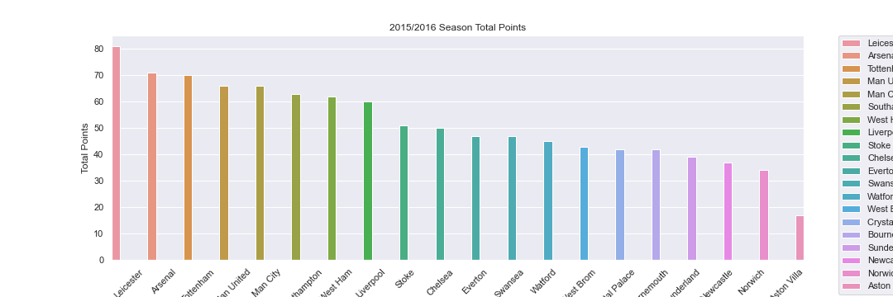
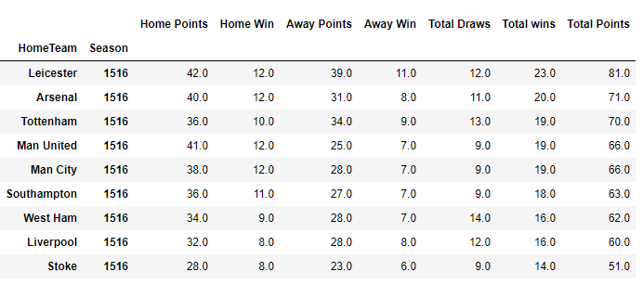
Data Analysis
2015/2016 season
Total points

Slide 6
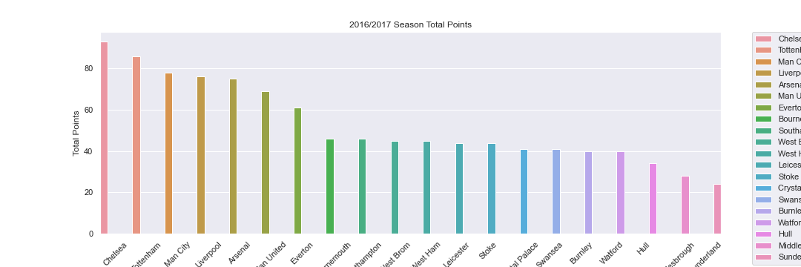
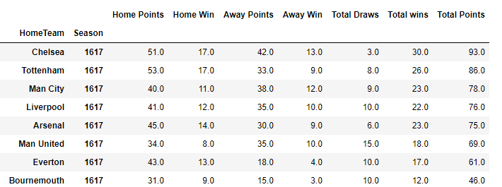
Data Analysis
2016/2017 season
Total points

Slide 7
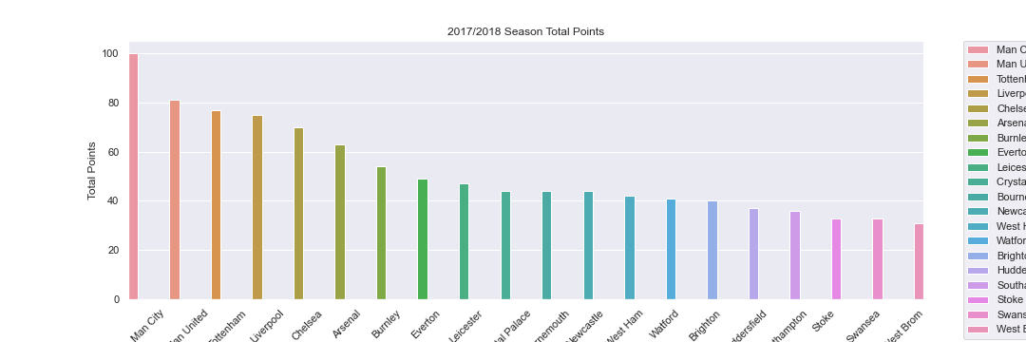
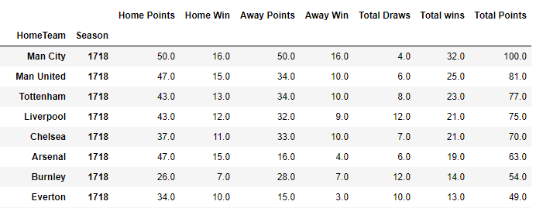
Data Analysis
2017/2018 Season
Total Points

Slide 8
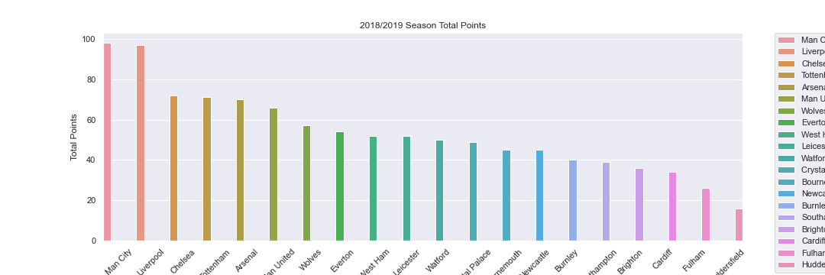
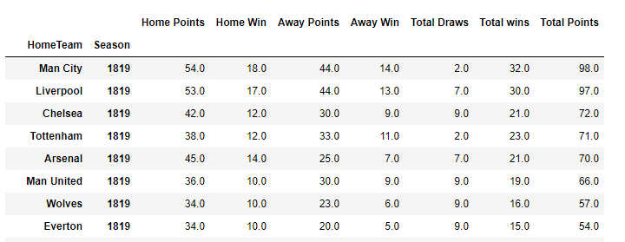
Data Analysis
2018/2019 Season
Total Points

Slide 9
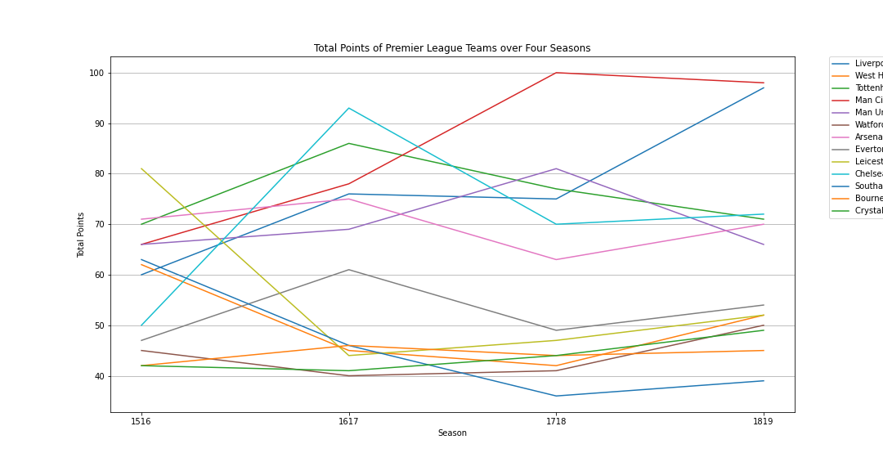
Data Analysis
Total points of teams
Over 4 seasons

Slide 10
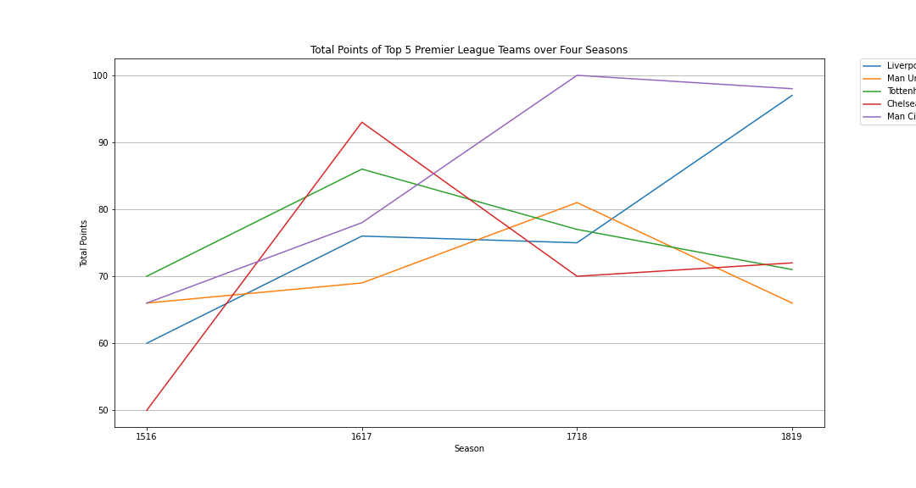
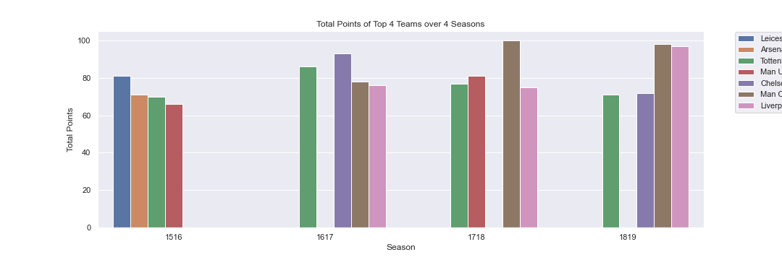
Data Analysis
Top 4 Team over 4 Seasons
Top Teams Overall over 4 Seasons

Slide 11
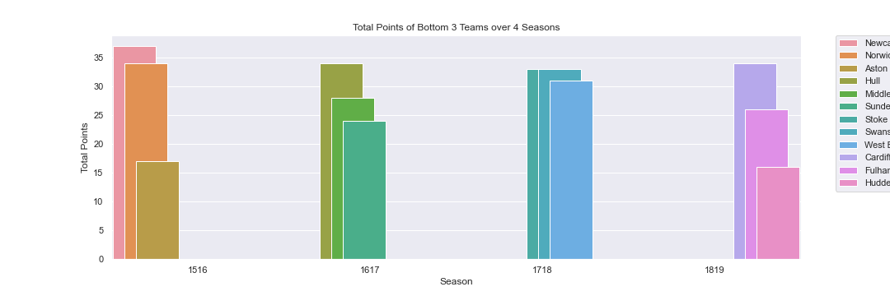
Data Analysis
Bottom teams over 4 seasons

Slide 12
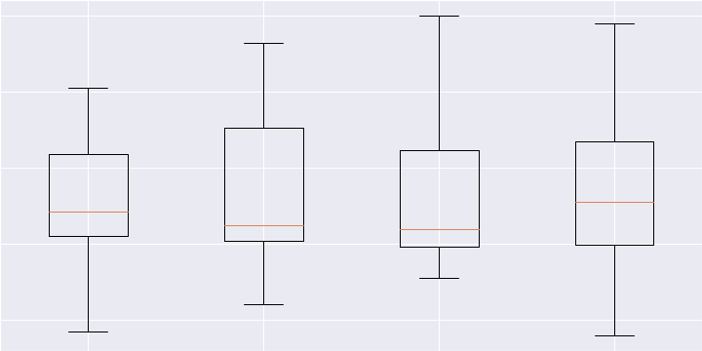
Data Analysis
Total Points by Season

Slide 13
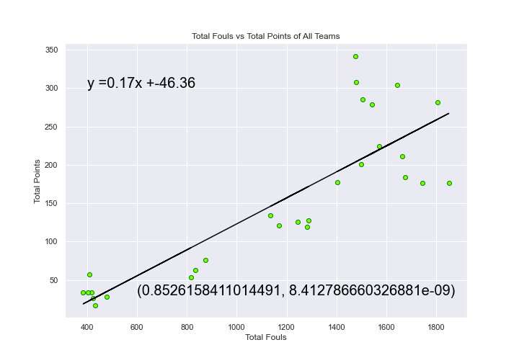
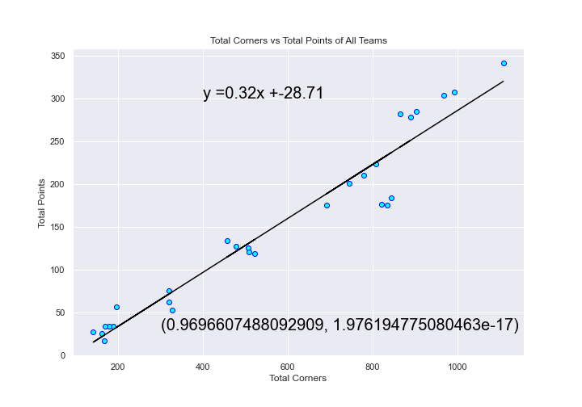
Data Analysis
Fouls vs Total Points
Corners vs Total Points

Slide 14
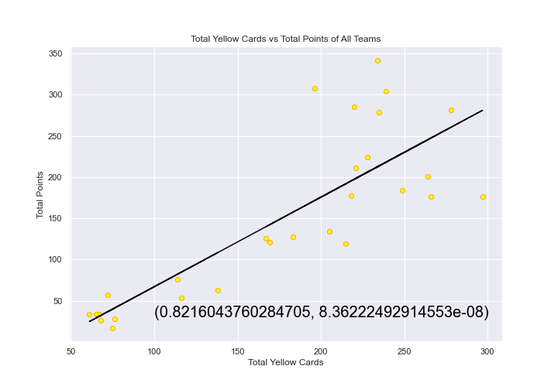
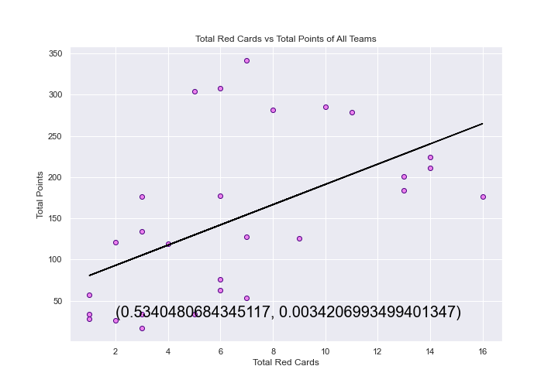
Data Analysis
Yellow Cards vs Total Points
Red Cards vs Total Points

Slide 15
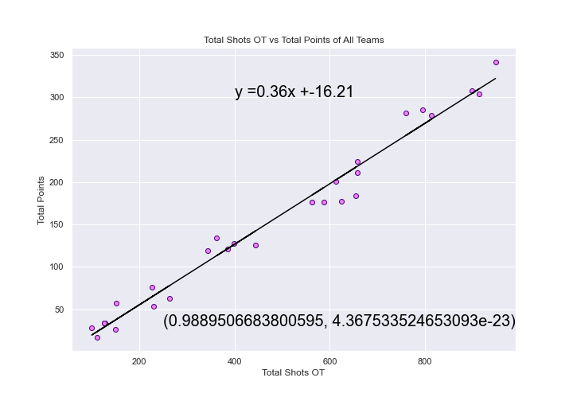
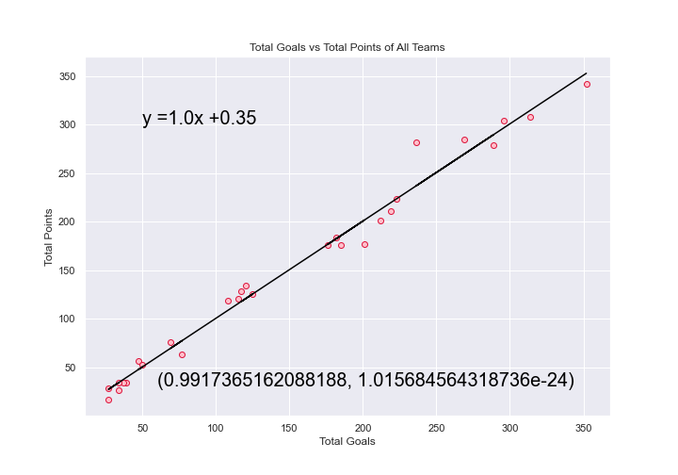
Data Analysis
Shots OT vs Total Points
Goals vs Total Points

Slide 16
Discussion
Everything that was found during the analysis was consistent with my predictions:
I was almost certain that there would be strong correlations between the different game stats and total points.
I knew, just from watching the sport, that there are some teams that consistently finish the season at the top of the table and the rest fluctuate from season to season.
I figured overall that the points would probably be consistent from year to year apart from the teams at the bottom and the top of the table.
Overall teams in the English Premier League preform evenly from one season to the next in terms of point totals. Even teams at the bottom and the top of the table preform consistently apart from a few outliers. Almost all game statistics heavily influence point totals increasing the odds of success.

Slide 17
Post Mortem
Importing Data – I had to create a loop in order to pull in CSVs while also adding in a column for the season
Calculating Points – Data only had the winner, but I need to know the how many wins, losses and draws
Grouping Data – Needed to group data by team and season but data was separated by home and away stats
Creating Plots – The line plots needed loops. The figures wouldn’t save properly
Additional questions? I wanted to take a closer look at the game stats of the top and the bottom teams for each season. Also, I wanted to track one individual team and look at their game stats over the 4 seasons to see how much the game stats influence the total points in reality. I thought it would also be interesting to see the differences between home and away performances.

Slide 18
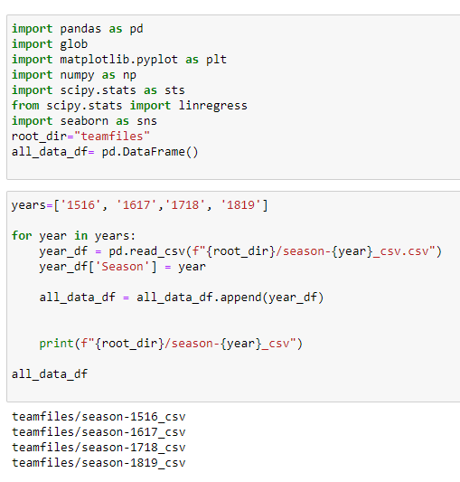

Slide 19
Post Mortem
Importing Data – I had to create a loop in order to pull in CSVs while also adding in a column for the season
Calculating Points – Data only had the winner, but I need to know the how many wins, losses and draws
Grouping Data – Needed to group data by team and season but data was separated by home and away stats
Creating Plots – The line plots needed loops. The figures wouldn’t save properly
Additional questions? I wanted to take a closer look at the game stats of the top and the bottom teams for each season. Also, I wanted to track one individual team and look at their game stats over the 4 seasons to see how much the game stats influence the total points in reality. I thought it would also be interesting to see the differences between home and away performances.

Slide 20
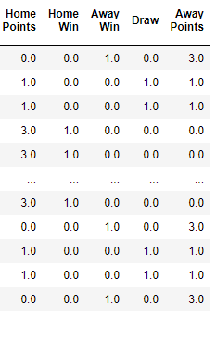
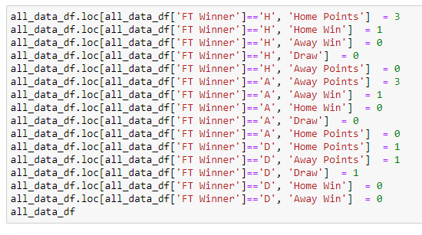

Slide 21
Post Mortem
Importing Data – I had to create a loop in order to pull in CSVs while also adding in a column for the season
Calculating Points – Data only had the winner, but I need to know the how many wins, losses and draws
Grouping Data – Needed to group data by team and season but data was separated by home and away stats
Creating Plots – The line plots needed loops. The figures wouldn’t save properly
Additional questions? I wanted to take a closer look at the game stats of the top and the bottom teams for each season. Also, I wanted to track one individual team and look at their game stats over the 4 seasons to see how much the game stats influence the total points in reality. I thought it would also be interesting to see the differences between home and away performances.

Slide 22
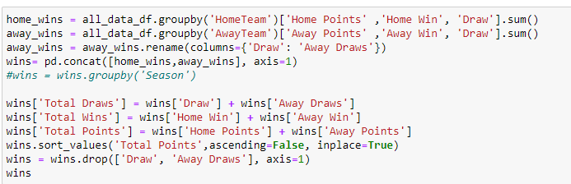
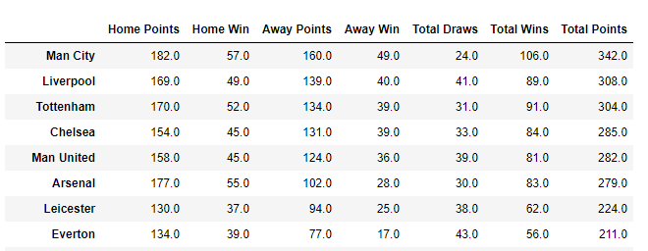

Slide 23
Post Mortem
Importing Data – I had to create a loop in order to pull in CSVs while also adding in a column for the season
Calculating Points – Data only had the winner, but I need to know the how many wins, losses and draws
Grouping Data – Needed to group data by team and season but data was separated by home and away stats
Creating Plots – The line plots needed loops. The figures wouldn’t save properly
Additional questions? I wanted to take a closer look at the game stats of the top and the bottom teams for each season. Also, I wanted to track one individual team and look at their game stats over the 4 seasons to see how much the game stats influence the total points in reality. I thought it would also be interesting to see the differences between home and away performances.

Slide 24
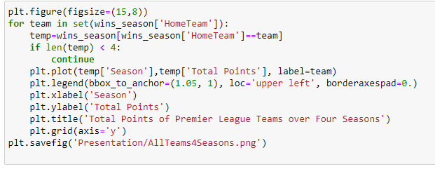

Slide 25
Post Mortem
Importing Data – I had to create a loop in order to pull in CSVs while also adding in a column for the season
Calculating Points – Data only had the winner, but I need to know the how many wins, losses and draws
Grouping Data – Needed to group data by team and season but data was separated by home and away stats
Creating Plots – The line plots needed loops. The figures wouldn’t save properly
Additional questions? I wanted to take a closer look at the game stats of the top and the bottom teams for each season. Also, I wanted to track one individual team and look at their game stats over the 4 seasons to see how much the game stats influence the total points in reality. I thought it would also be interesting to see the differences between home and away performances.

Slide 26

Questions?

